Slide 1
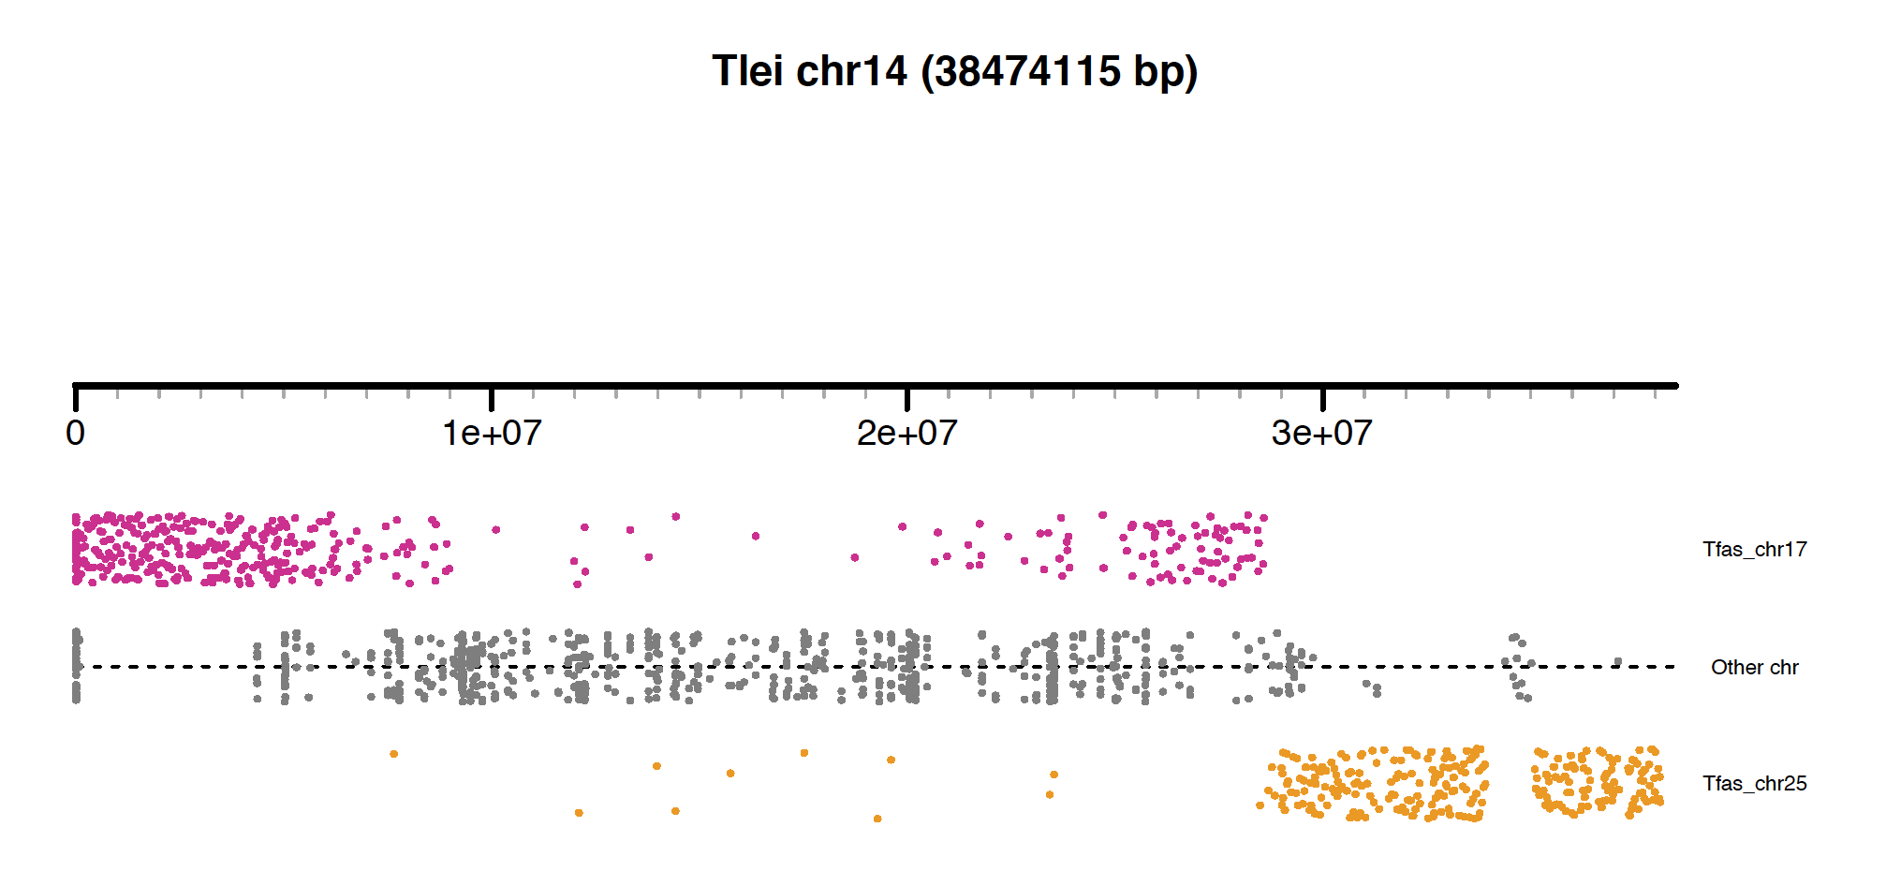
Notes:
Alignments only filtered by length (> 8 kb) and identity > 0.8

Slide 2
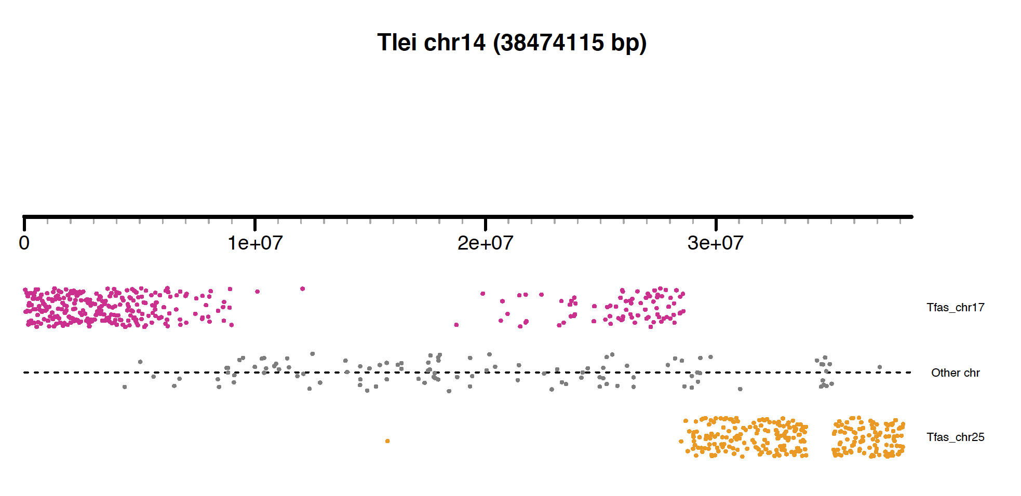
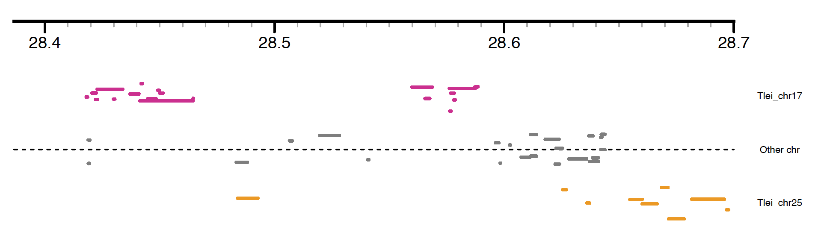
~ 36.8 kb
~ 50 % overlap with alignment from another chr
Notes:
Only alignments < 0.9 overlap
28.588.630 – 28.625.508 = 36.878

Slide 3
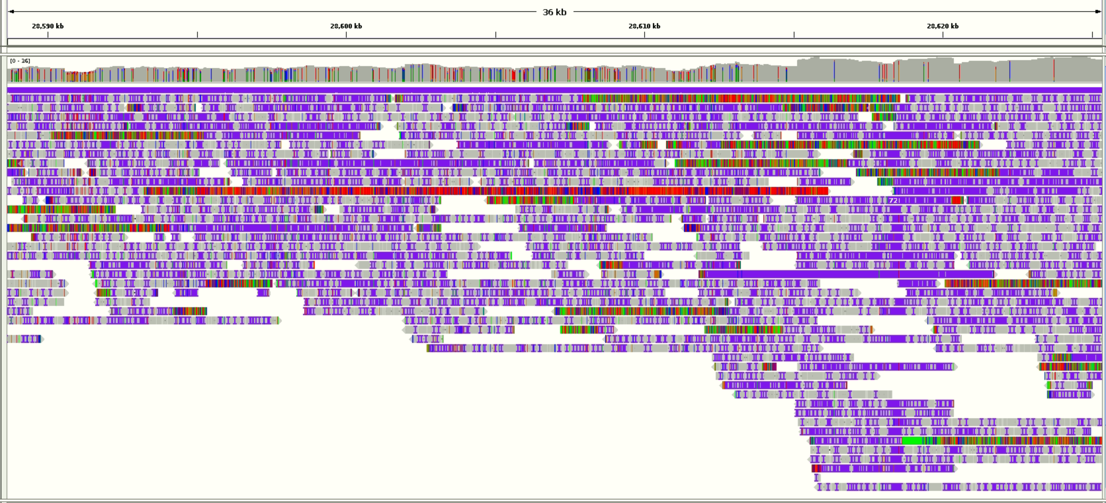
Raw pacbio data seems to span the region continuously

Slide 4
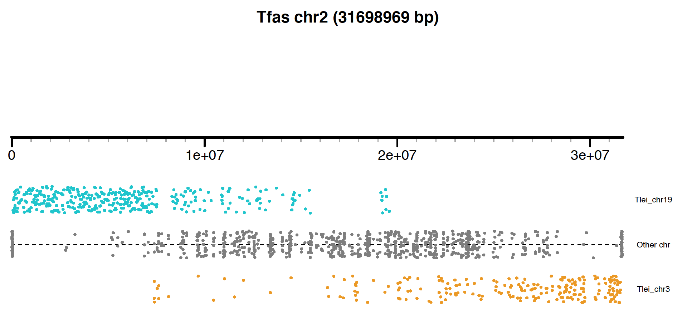
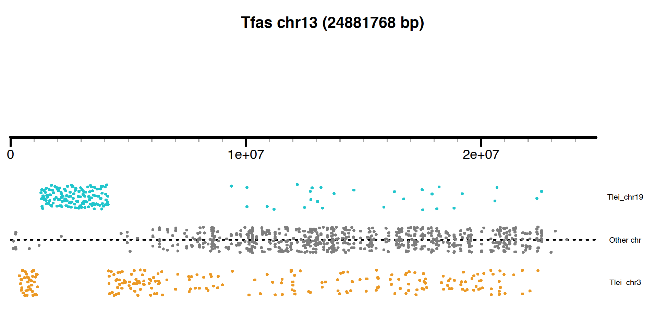
Notes:
No uniqueness filter

Slide 5
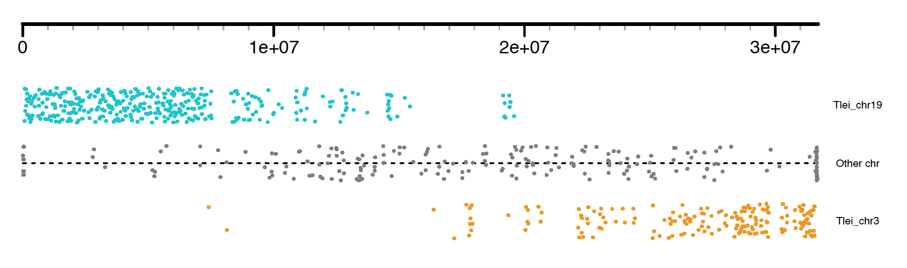
After removing non-unique alignments, it looks even more like each arm of chromosome 2 is syntenic with chromosomes 19 and 3 in Tlei.
However the resolution of alignment is too low to determine a breakpoint.

Slide 6
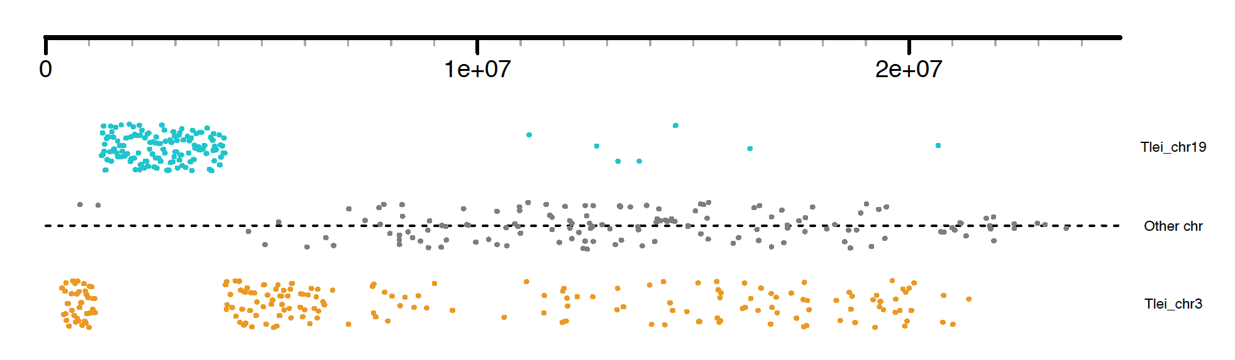
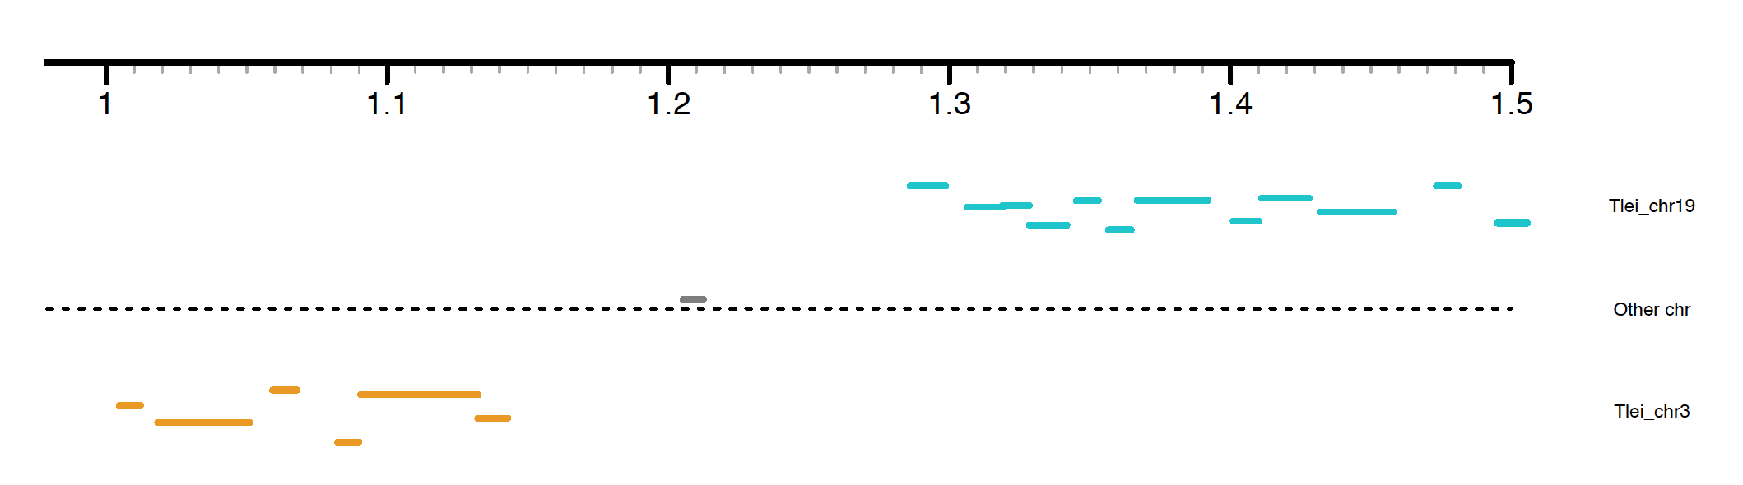
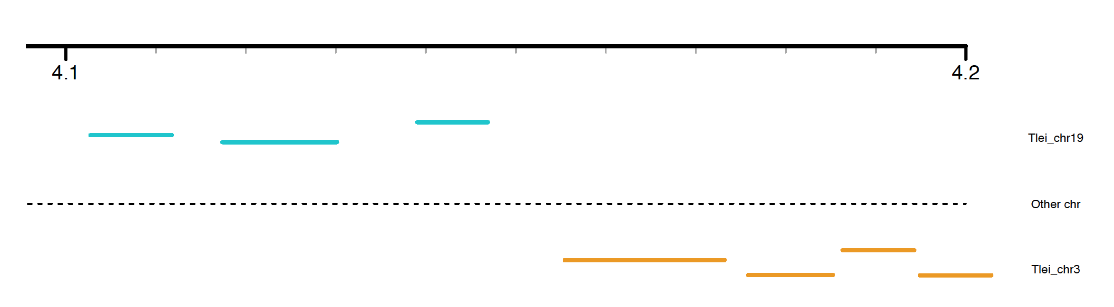
~ 140 kb
~ 8.5 kb
Notes:
Breakpoint 1: 1.142.870 – 1.286.057 = 143.187
Breakpoint 2: 4.146.882 – 4.155.429 = 8.547

Slide 7
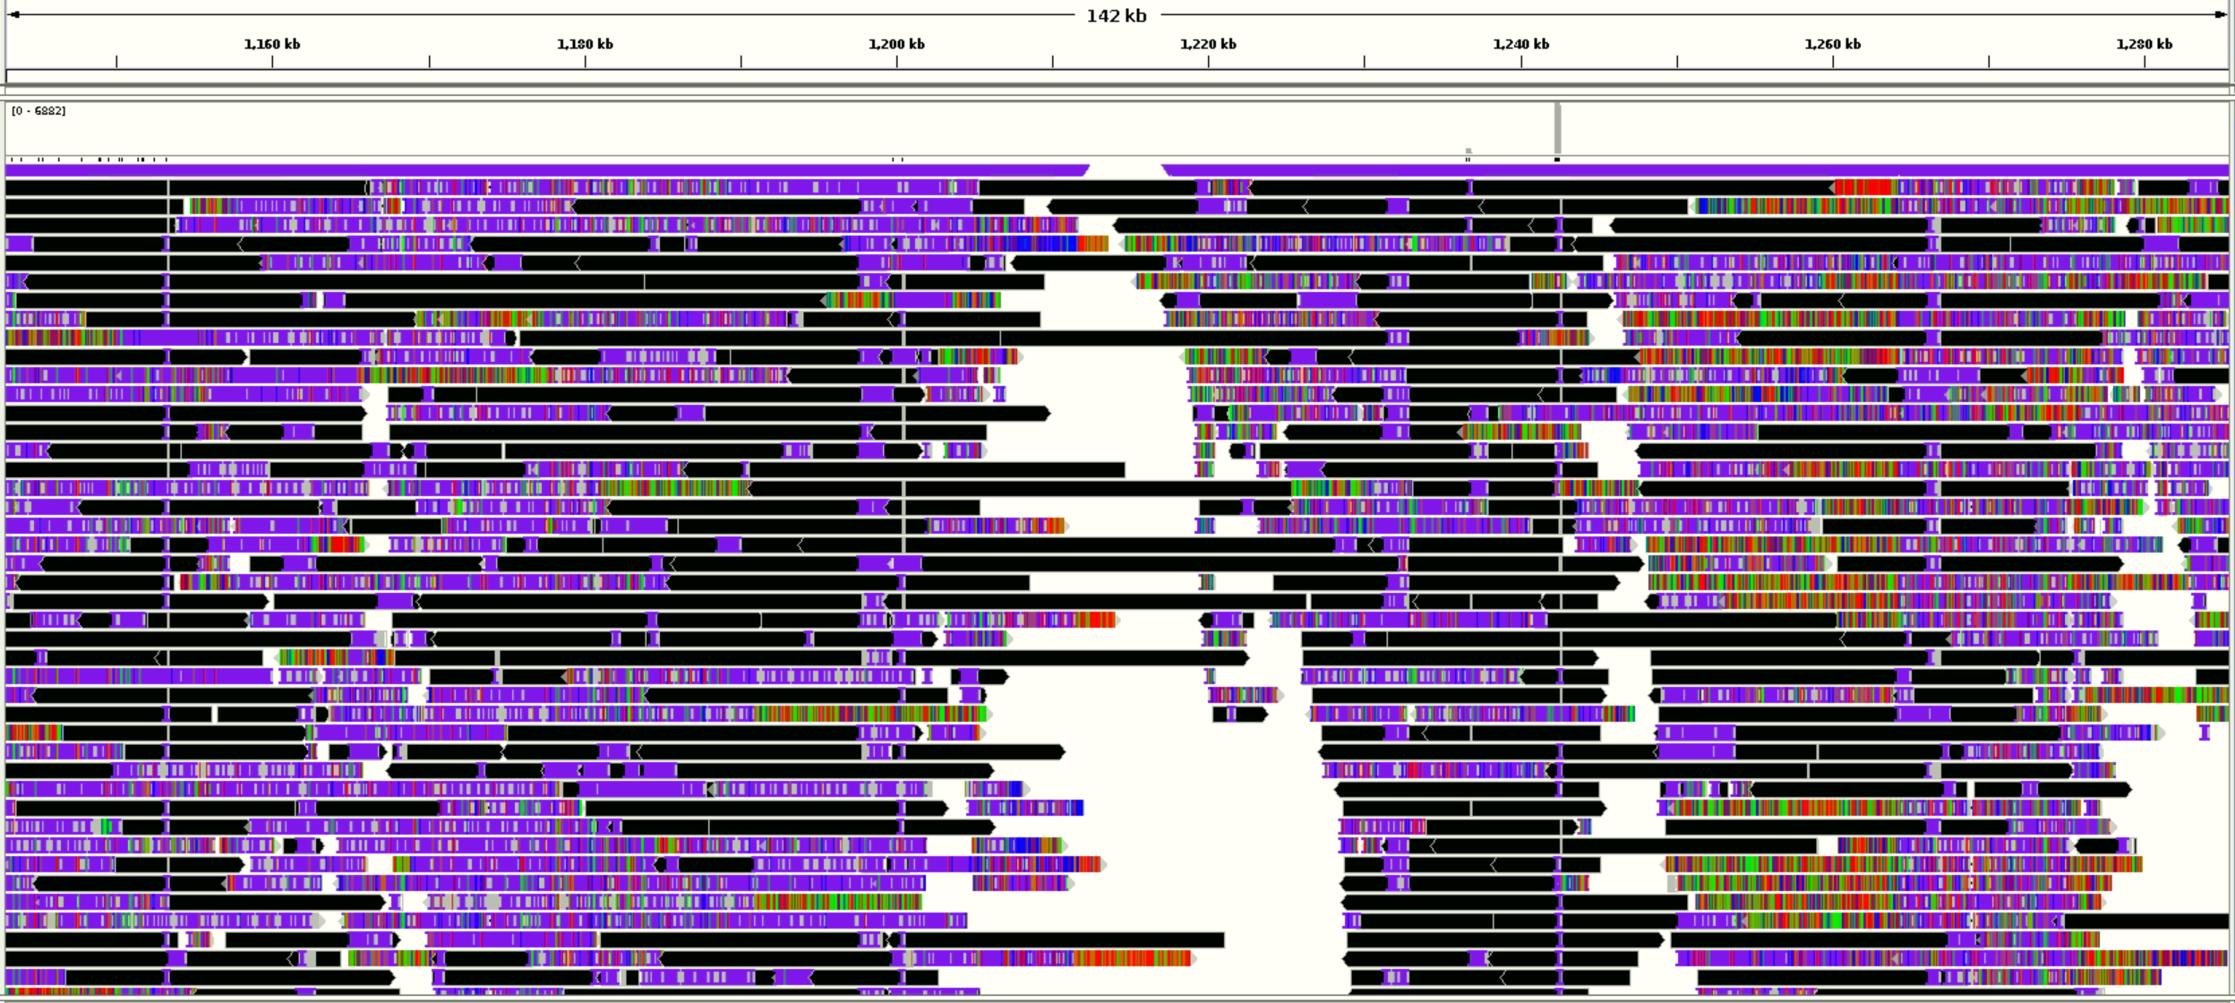
Breakpoint 1 – black are softclipped bases. There seems to be a gap in the alignment.

Slide 8
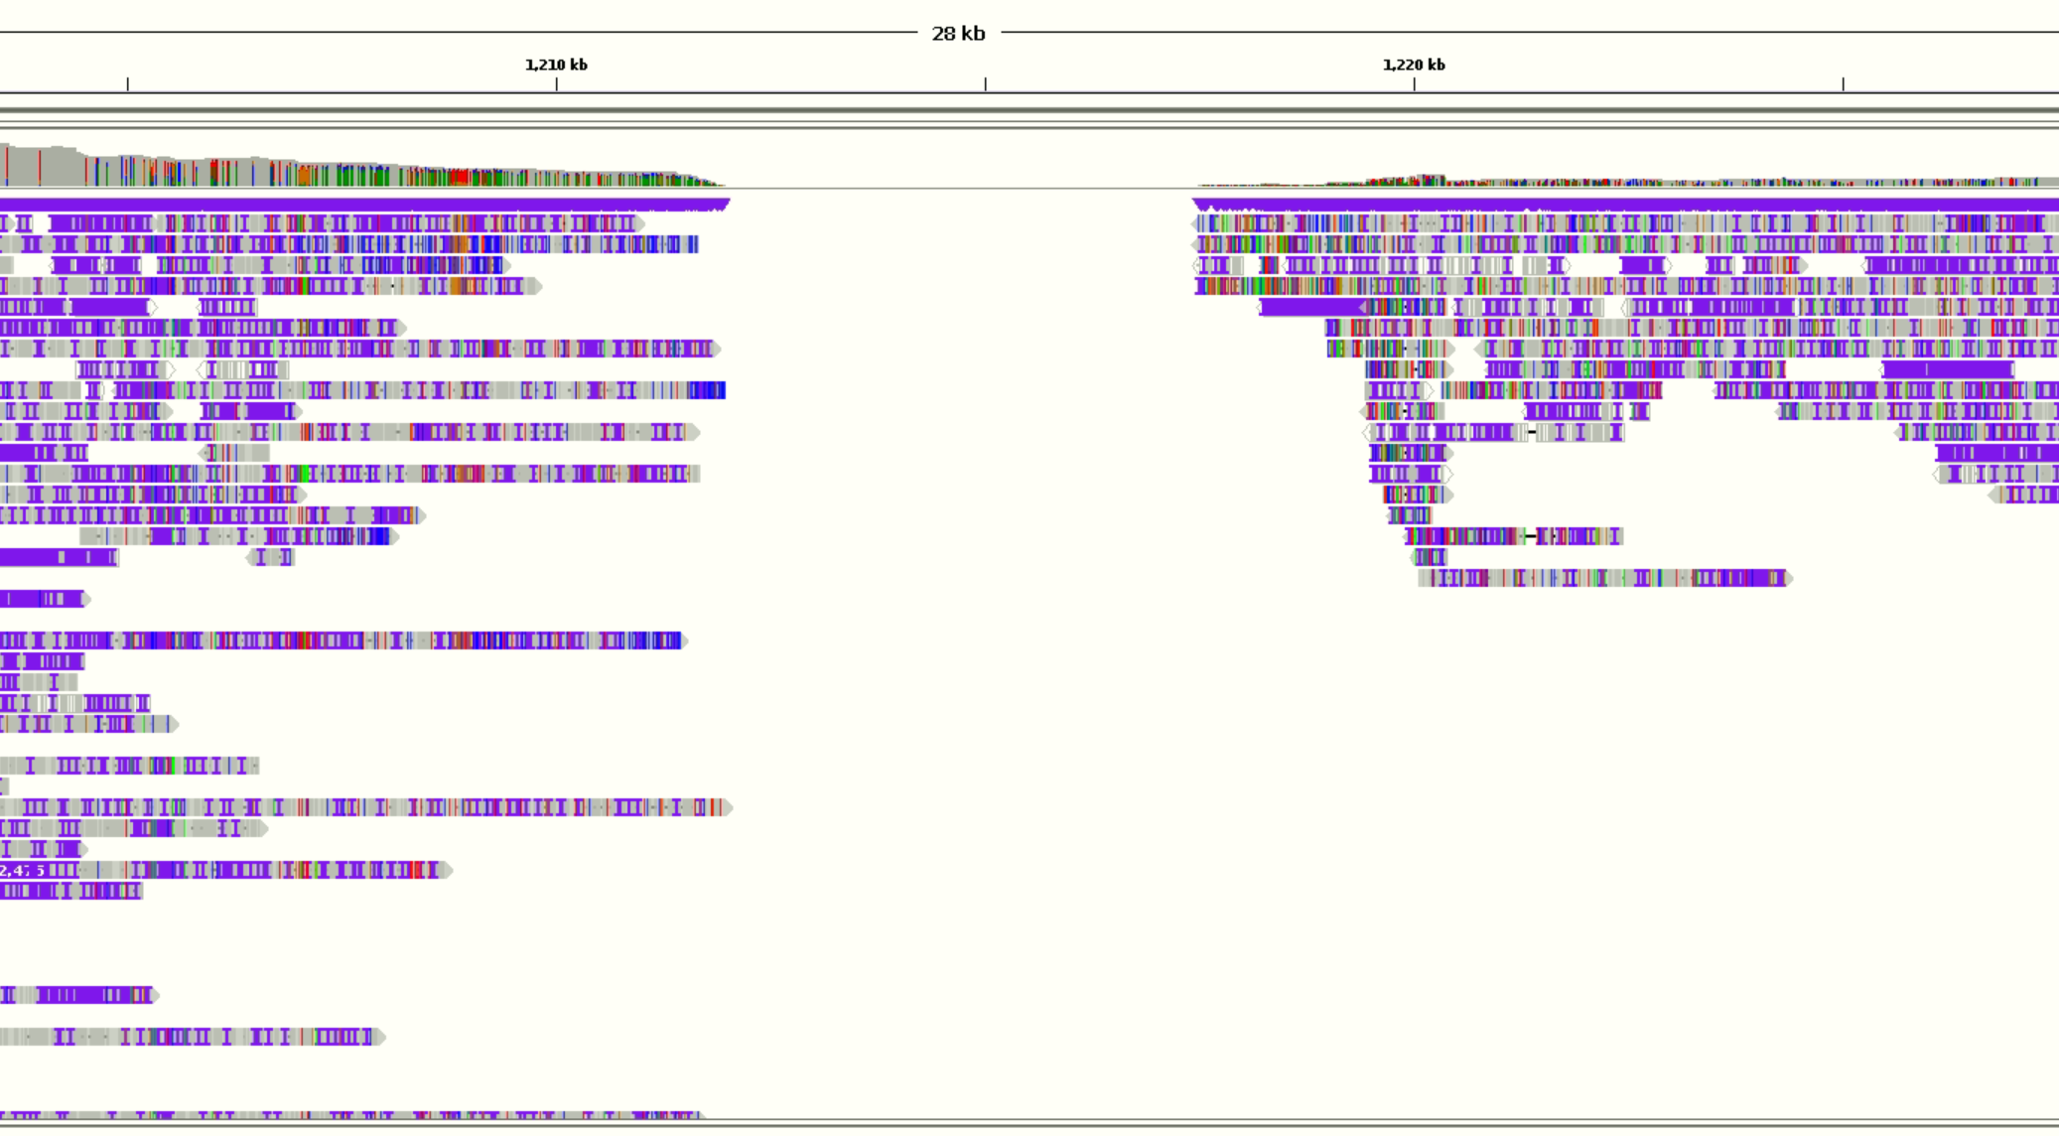
Breakpoint 1 – black are softclipped bases. There seems to be a gap in the alignment.
Importantly, the sequence is not a gap of Ns here

Slide 9
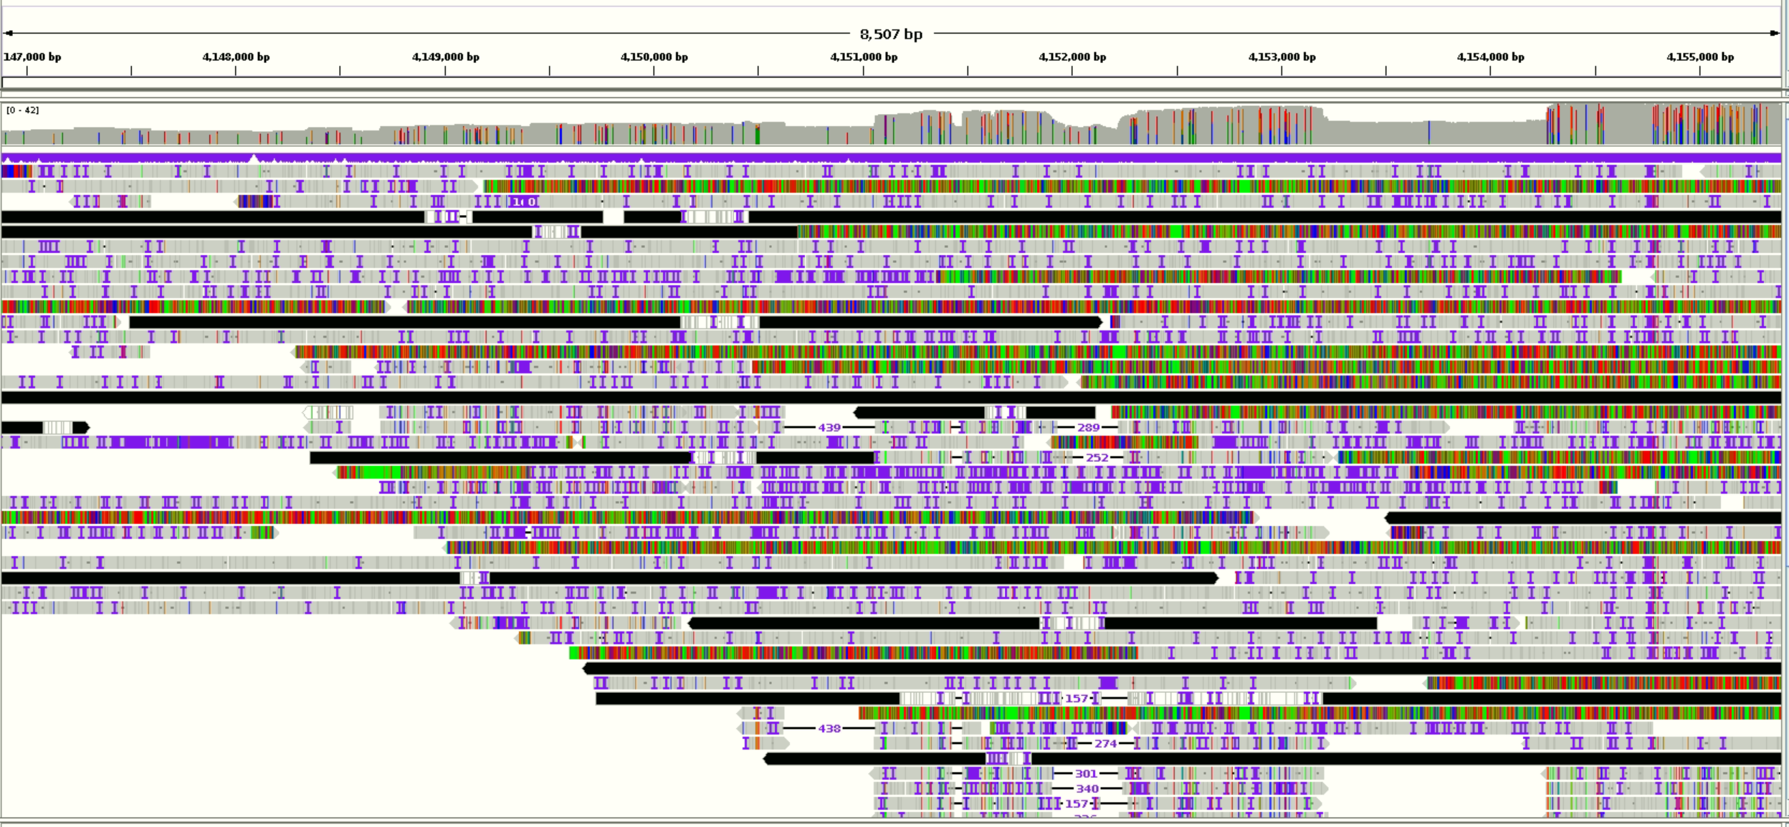
Breakpoint 2.

Slide 10
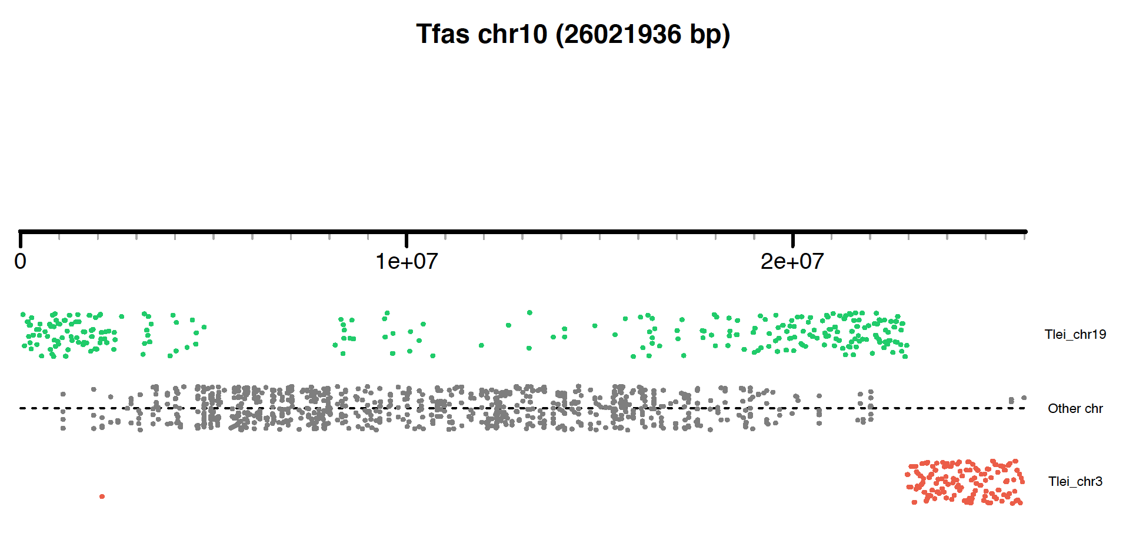
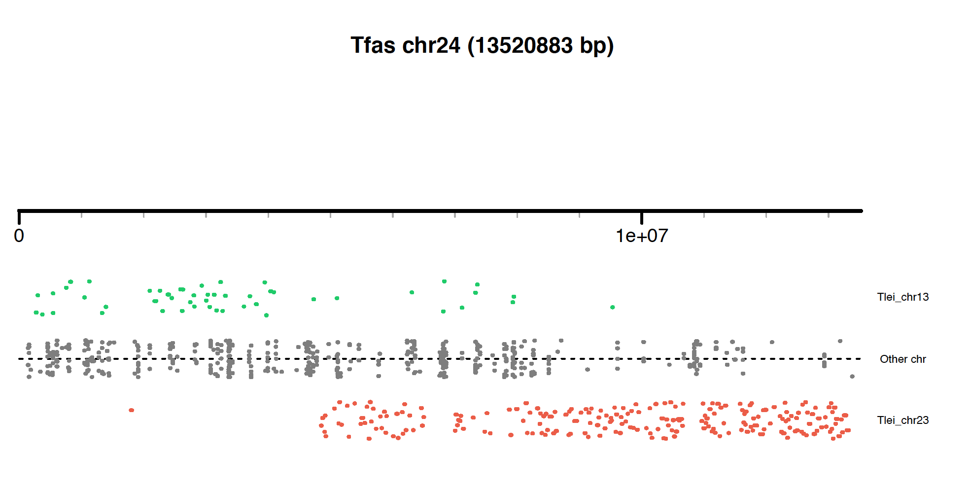
Notes:
No uniq filtering

Slide 11
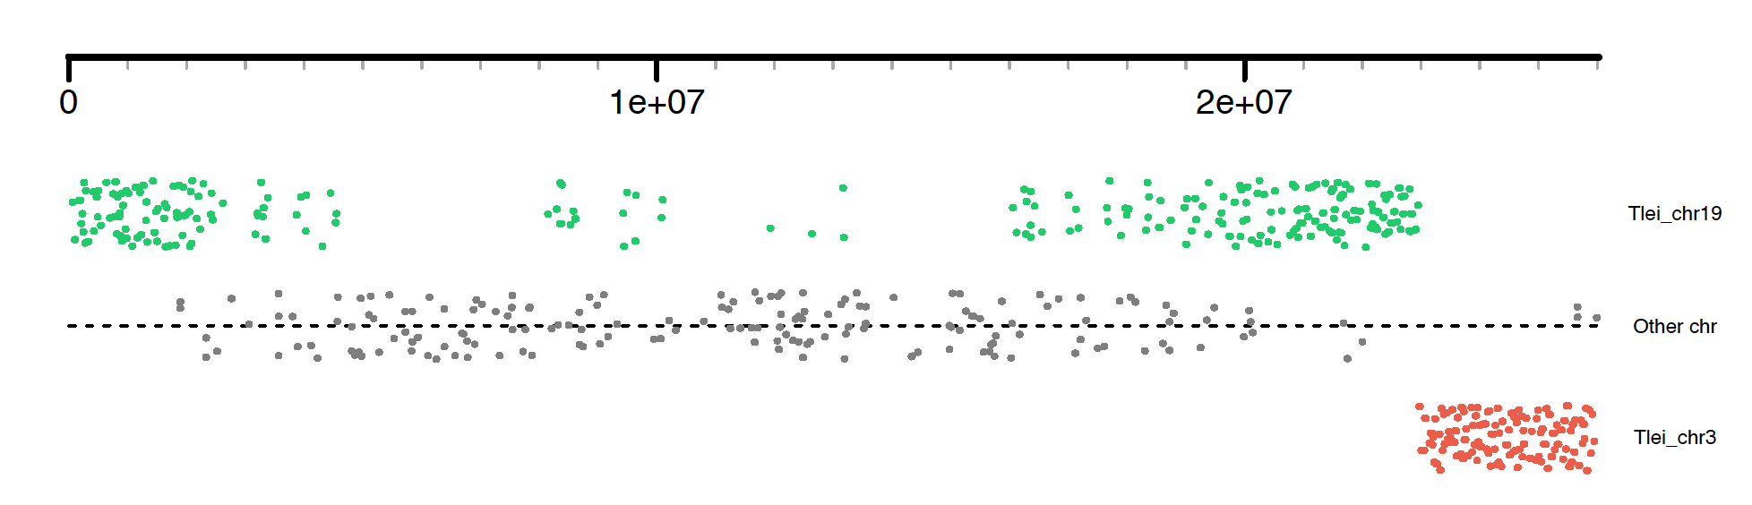
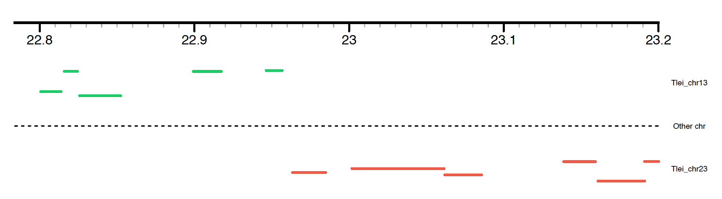
~ 6.6 kb
Notes:
Breakpoint: 22.956.800 – 22.963.481

Slide 12
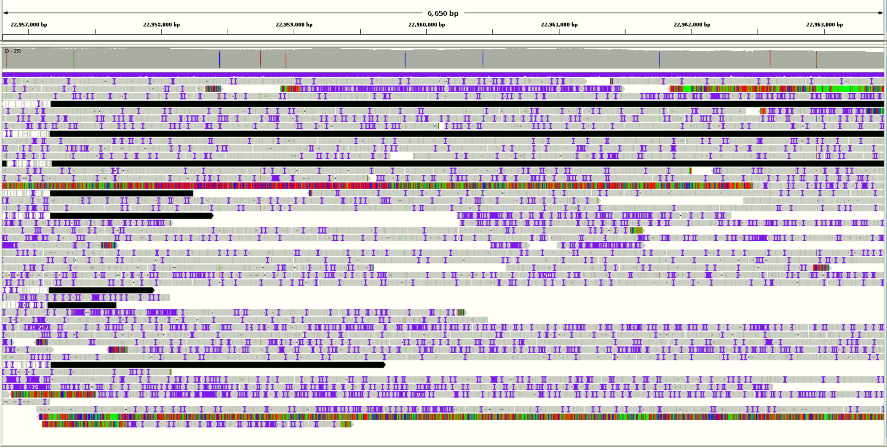

Slide 13
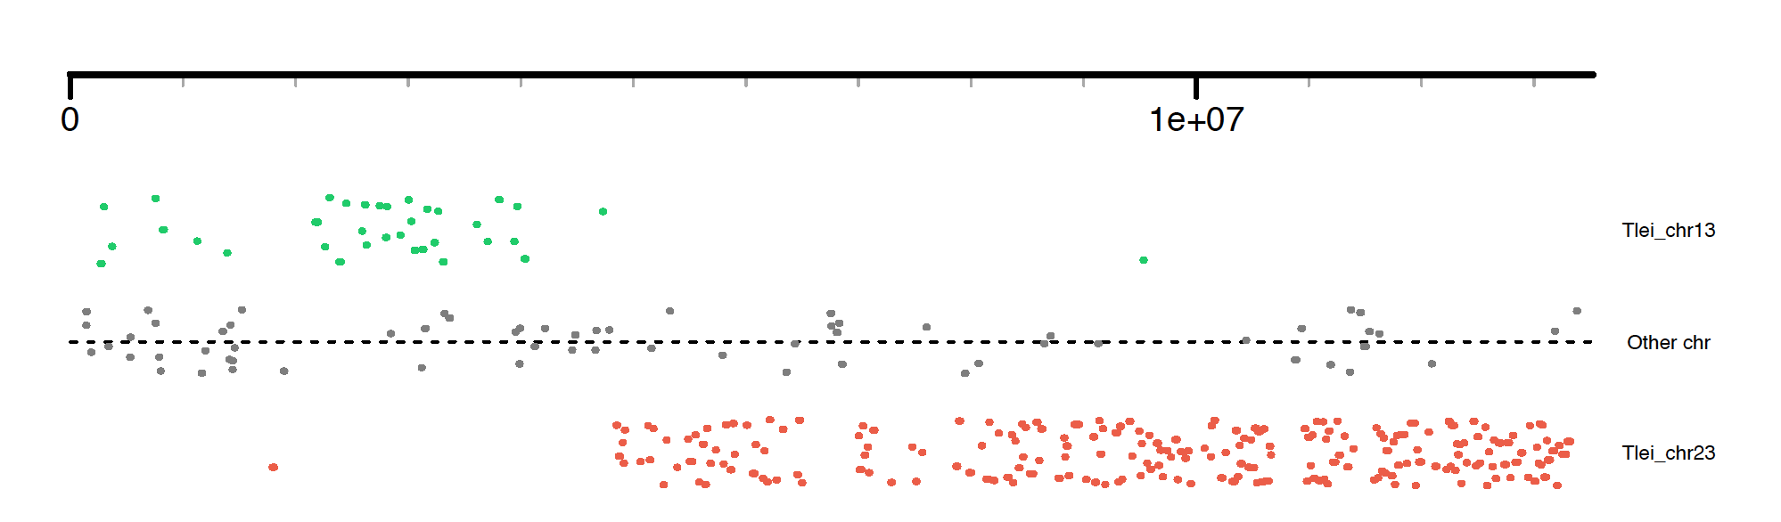
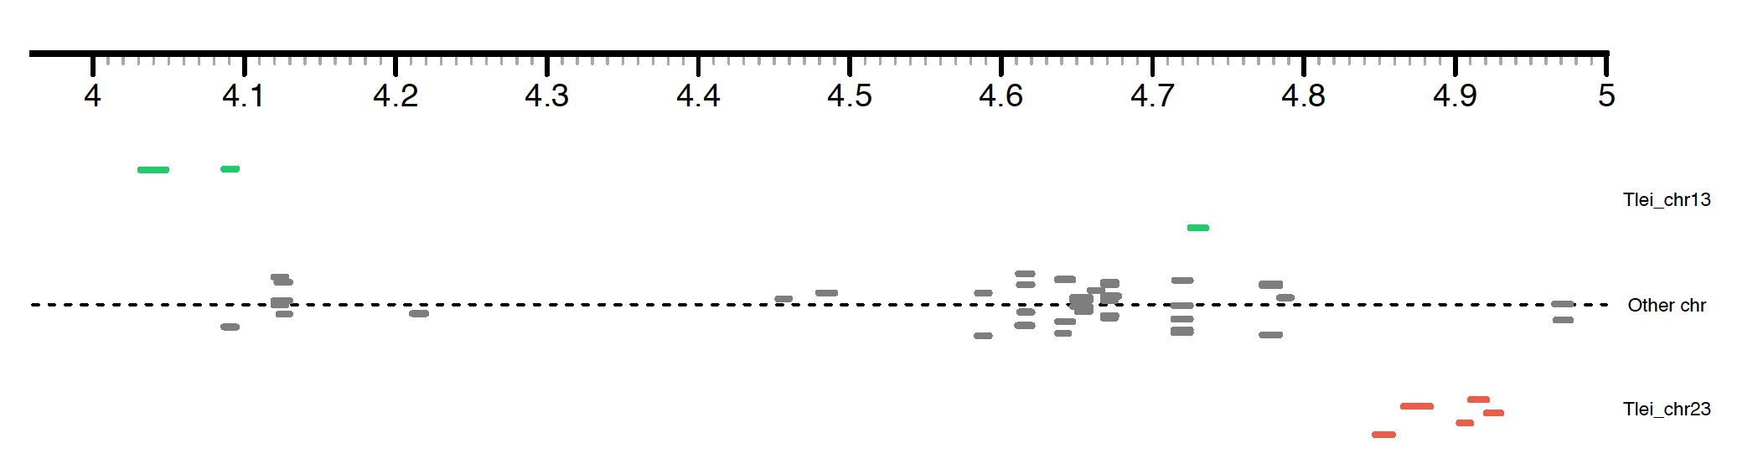

Slide 14
